Slide 1
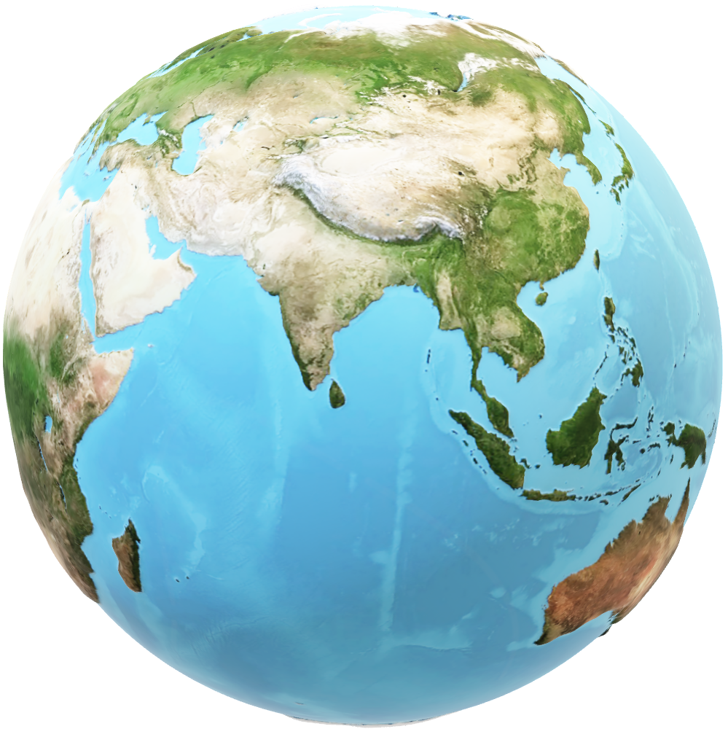
DEEP DIVE
MEXICO

Slide 2
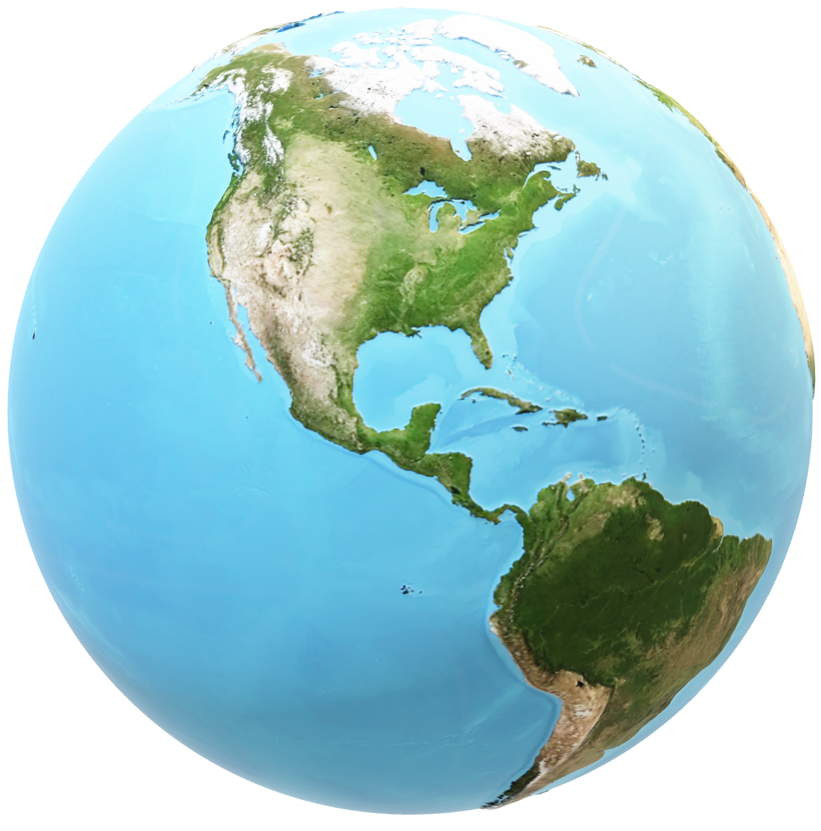
POPULATION :
126M
LANGUAGE:
SPANISH
CURRENCY:
MXN PESO

Slide 3
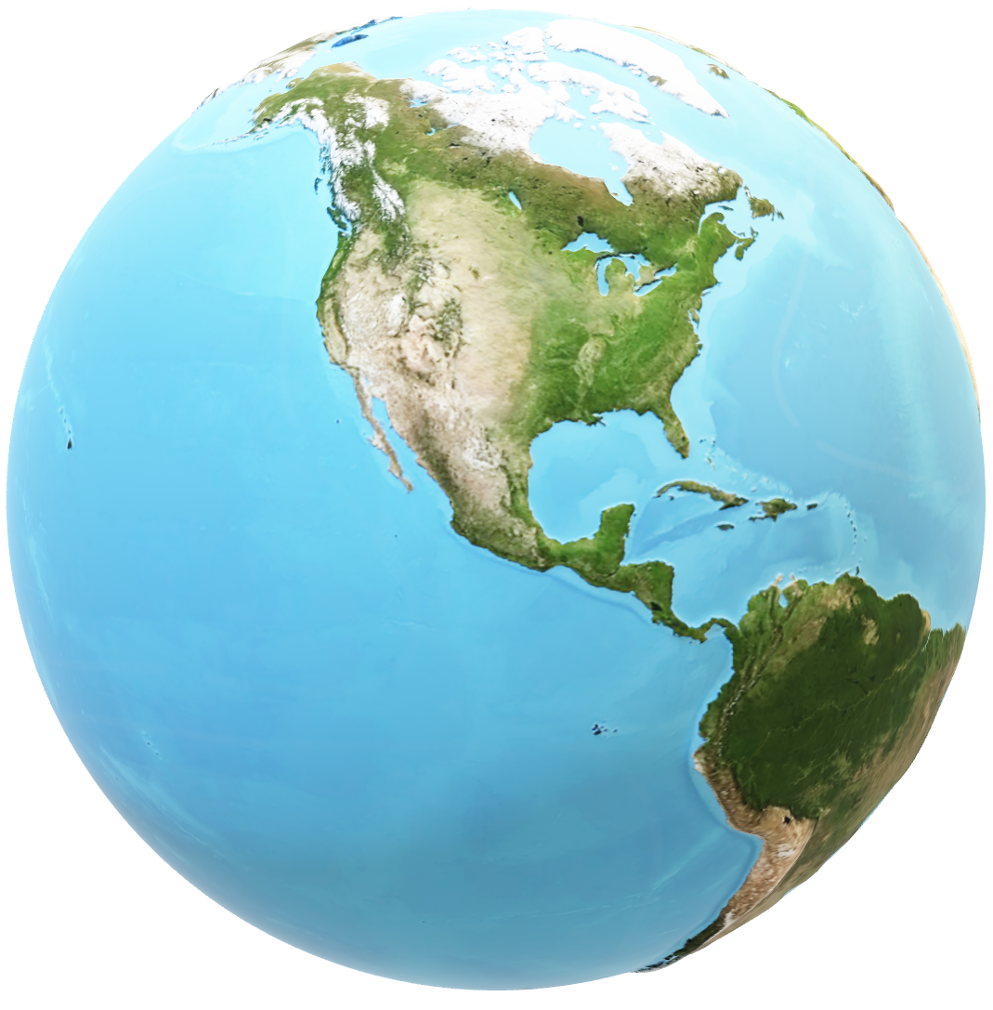
POPULAR PLACES :
MEXICO CITY
CANCÚN
MERIDA
OAXACA

Slide 4
